Slide 1
Data Analysis: Taipei Parking
指導教授︰
謝東儒教授
參與人員︰
102590050 樊家麟 (Edward)
102590452 胡智傑 (Jerry)

Slide 2
Content
Motivation
Purpose
Hypothesis
Design Process
Expecting Result
Conclusion
Reference

Slide 3
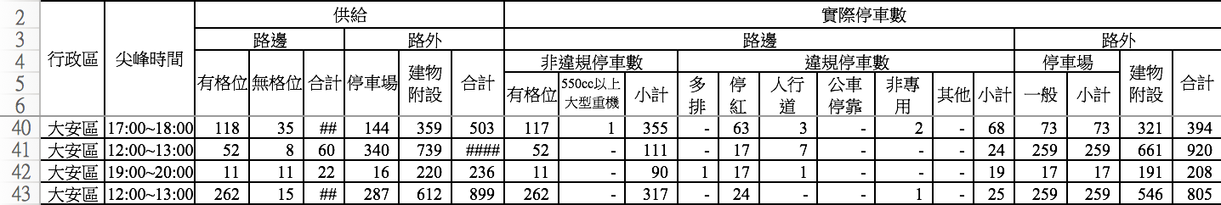
Motivation
We participated the MIT Media Lab Workshop, finding that using the data analysis system making by the lab researcher to analyze data is convenient to reveal the information.
There are the public parking spaces problem of lacking and excessive in somewhere

Slide 4
Purpose
Finding out the relationship and implementing them to the data analysis system
The distributions of the parking lots in Taipei
The economic distributions in Taipei
The cars distributions in Taipei
Land use in Taipei
The cost of the house in Taipei

Slide 5


Hypothesis
High Income
More Public
Parking Lots
More Cars
High Density
Residential Area
More Public
Parking Lots
More Cars
Commercial Area
More Need
of Spaces
More Public
Parking Lots
Fig 1. Hypothesis

Slide 6
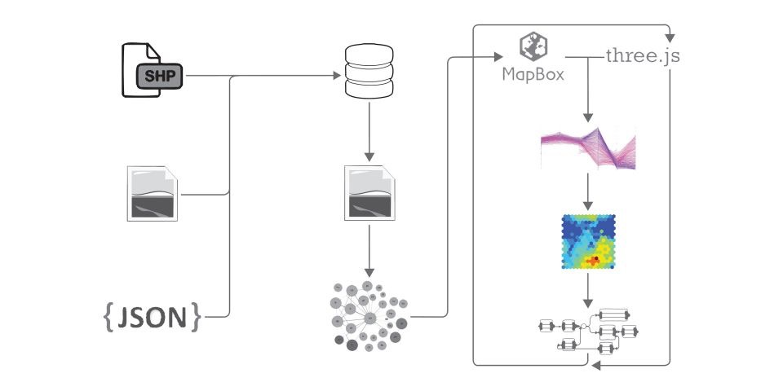
Design Process
1
2
3
Fig 2. The design process

Slide 7
Design Process
1
Flirting the meaningless data
Transferring the crawled data with Google API to geocode
2
Using QGIS to construct the file with the suitable format that the website request
3
Performing on the website and finding out the relationship between the data

Slide 8
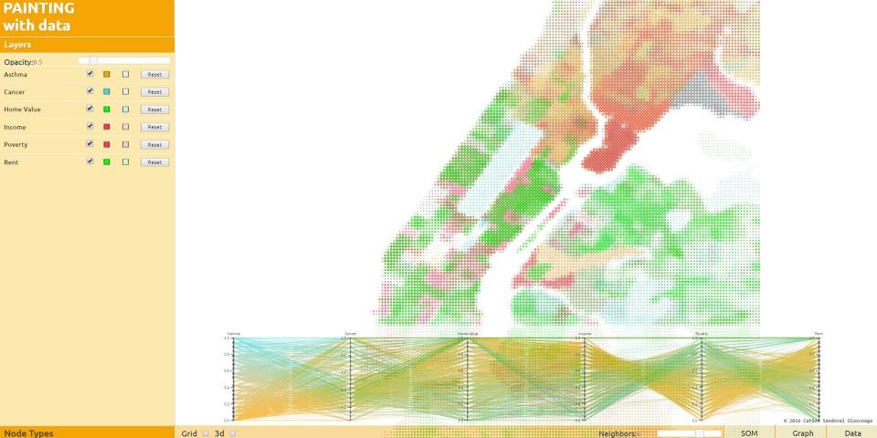
Expecting Result
This is the asthma, cancer, home value, income, poverty, rent of New York City showing in the raw result
Pic 3. Expecting result (1)

Slide 9
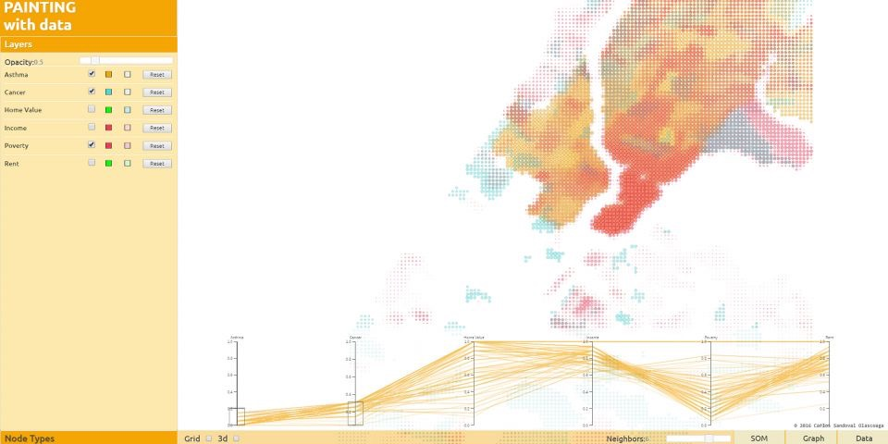
Expecting Result
We can find out the relationships between the data by adjusting the bar and then the intersecting data will show out
Pic 3. Expecting result (2)

Slide 10
Conclusion
Revealing the uneven distribution of parking spaces and parking lots
Knowing nowadays public parking situation
Through data analysis to find out the relation between each others

Slide 11
Reference
[1] Carlos Sandoval Olascoaga, Paintingwith Data,
http://paintingwithdata.mit.edu/about
[2] Carlos Sandoval Olascoaga,
https://github.com/cesandoval/PaintingwithData_Riyadh
[3] QGIS, A Free and Open SourceGeographic Information System
http://www.qgis.org/en/site/
[4] MIT Architecture, Project Painting withData: From a Computational History ofUrban Models to an Alternative UrbanComputing
https://architecture.mit.edu/computation/project/painting-data- computational-history-urban-models-alternative- urban-computing
[5] MIT CITY SCIENCE 春季黑客松 @TAIPEITECH
http://cities.media.mit.edu/taipei

